Slide 1



One Nutrition Coverage Survey

Slide 2
Training Module: Sampling, Mapping, Household Listing, and EA Segmentation Procedures

Slide 3
Sampling and Mapping Households

Slide 4
Overview of the Process
Steps for Sampling and Mapping Households:
  EA Boundary Identification
  Household Listing
  Random Sampling of Households
  Sample Allocation to Interviewers
  Data Collection using CAPI with Integrated Maps

Slide 5
EA Boundary Identification
Definition:
An Enumeration Area (EA) is a geographic unit used for census or survey data collection, typically containing around 80–120 households
Steps to Identify EA Boundaries:
Teams use digital and printed maps
Verify physical boundaries through reconnaissance (landmarks, roads)

Slide 6
EA Boundary Identification
Preparation for EA boundary identification: Before visiting the cluster, the mapping team must ensure they carry the following:
  Identification: Official ID card or introductory letter (issued by BNNC, APSU, icddr,b, or BBS).
  ID Badges: Identification badges for all team members.
  Contact Information: Phone numbers of the Data Management Officer (icddr,b headquarters), Survey Coordinator, and Supervisors.
  Operations Manual/Guidelines: Survey operations manual or field implementation guidelines.
  EA List: List of assigned EAs with identification details.
  Maps: Physical base maps of sampled EAs and tablets with digital maps.

Slide 7
Use of digital maps at the field level for EA boundary identification
EA maps supplied: Provided by BBS and digitized by icddr,b using GIS.
Merging EAs: EAs with fewer than 80 households merged with adjacent EAs.
Shapefiles in CAPI: Digital shapefiles uploaded to CAPI via KoboToolBox.
Google Maps: Used by field teams to locate EAs.
Map distribution: 164 EAs shared with teams in both digital and printed formats.
EA allocation: Assigned to teams as per icddr,b’s fieldwork schedule.
Cluster verification: Supervisors confirm correct cluster using GPS and digital maps.

Slide 8
Identifying EA Boundaries with Guidance from Local Authorities (and BBS Local Officials as Necessary)
Meeting local authorities:
Supervisors will introduce themselves to local authorities.
They will collaborate with Union and Upazila authorities, BBS officials, and, if necessary, seek support from local residents.
Explaining the purpose of the study:
Supervisors will explain the objectives of the research and mapping activities to authorities and community members.
Role of the guide:
A community leader or local BBS official will act as a guide, helping community members understand and accept the presence of the data collection team.

Slide 9
Identifying EA Boundaries with Guidance from Local Authorities (Continued)
Identifying EA boundaries:
Work with local authorities and residents to identify the EA boundaries.
Defining EA boundaries:
Once identified, the team will formally establish the EA boundaries.
Reconnaissance walk:
Identify natural divisions within the EA (e.g., roads, blocks, neighborhoods, boundary walls, open fields, or landmarks such as schools, mosques, and markets).
Dividing dwellings into clusters:
Based on the size of the EA and other considerations, supervisors or co-supervisors will help divide dwellings into clusters near natural boundaries.
Starting the household listing:
Begin listing households sequentially from one edge of the EA boundary.

Slide 10
Activity (EA Boundary Identification)
Purpose: To ensure participants understand how to identify EA boundaries using maps and physical landmarks
Activity: Use of sample EA maps to demonstrate how boundaries are defined
Group Exercise:
    Printed or digital EA maps to participants will be provided
    Participants will be asked to identify EA boundaries and natural landmarks
Debrief: Discuss the identified boundaries and clarify common issues like overlapping EAs or unclear boundaries

Slide 11
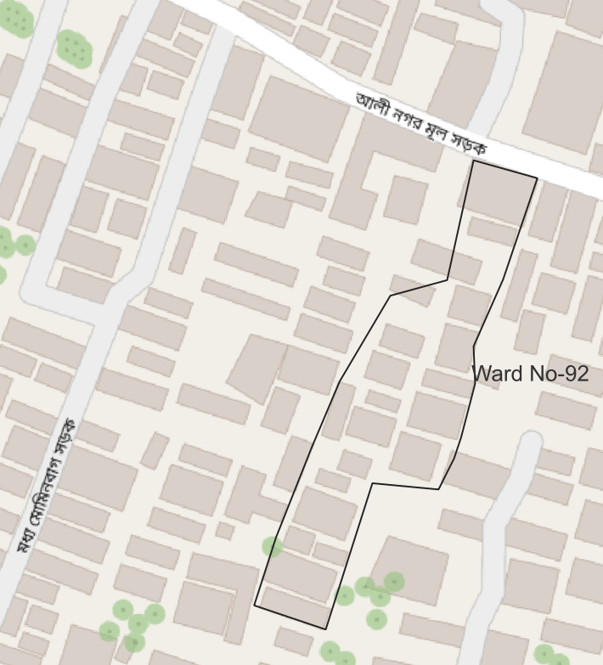
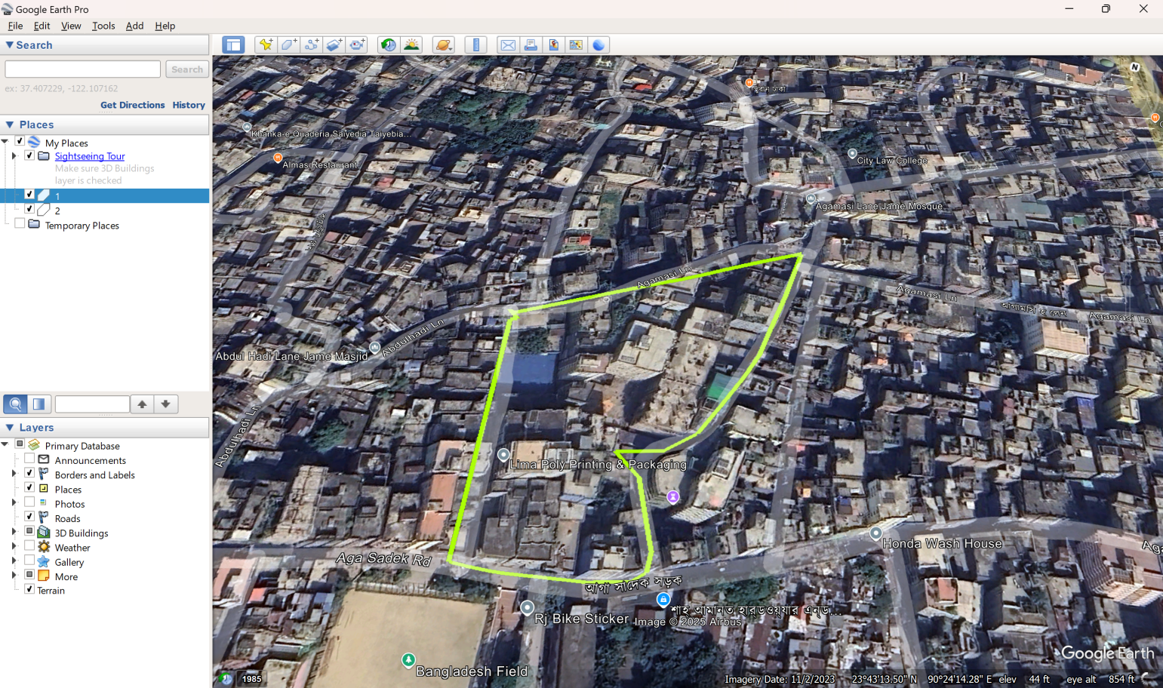
Mapping example

Slide 12
Household Listing

Slide 13
Household Listing
Purpose:
To create a complete and accurate sampling frame of all households within the EA
  Process for Household Listing:
  Enumerators will list all households during the initial visit
  A unique number auto-generated by the CAPI system for tracking
  The household location will be recorded using GPS
  Address and Dwelling Type: Details about the household's location and structure (e.g., permanent, semi-permanent)

Slide 14
Household Listing (contd.​)
Record locked/absent households (exclude from final selection)
Supervisor defines listing start and end points
Verify multiple households within a dwelling
For multiple wives: count as one HH if supported by the same person
For rural doctors: register only permanent residents and family members
Mark unclear Upazila/Mouza boundaries
Collect additional key info: HH head name, phone number, pregnant women in HH
Obtain consent before data collection

Slide 15
Household Listing Exercise
Walking through the EA:
  Visit each household systematically (e.g., clockwise or street-by-street)
Recording of Household Information:
  Assign a unique ID to each household
  Record the following details:
    Household Head’s Name, address or Landmark, type of settlements
    GPS Coordinates (if available), any pregnant woman
Example of Household Listing Table:
HH ID | HH Head | Address / Landmark | Type of HH | GPS Coordinates | Pregnant woman
1 | Mr. Abdul Baten | Near Main Road, Block A | 1 2 | 12.3456° N, 45.6789° E | 1=No 2=Yes
2 | Ms. Jane Smith | Next to School, Block B |  | 12.3460° N, 45.6795° E
3 | Mr. Ahmed Ali | Opposite Mosque, Block C |  | 12.3470° N, 45.6800° E

Slide 16
Random Sampling of Households
Purpose: To obtain a representative subset of the population, ensuring unbiased and fair analysis
Method:
Use of simple random sampling to select 20 households from the list in each EA
Steps:
  Generate a random sample of 20 general households using the CAPI system’s built-in random number generator
  Additionally, select two households with pregnant women where available
  Ensure no duplicates in the selected sample
  Mark selected households on the integrated EA map in CAPI for easy identification by interviewers
  Upload and sync household listing data before randomization
  CAPI automatically generates the random sampling frame
  Randomly assign selected households to enumerators

Slide 17
Sample Allocation to Interviewers
Process:
Selected households will be divided into smaller groups based on proximity
Groups of households will be assigned to interviewers to balance workload
Interviewers will be provided with:
  A list of sampled households will be generated by CAPI
  Integrated EA map with marked sampled households
Key Consideration:
Each interviewer will be required to cover all assigned households and revisit unavailable households as necessary
Synchronizing for getting the random list of HHs

Slide 18
Sample Allocation Example
Household ID | Household Head | Random Number
001 | Household Head 1 | 0.704685154
002 | Household Head 2 | 0.774133229
003 | Household Head 3 | 0.259798829
004 | Household Head 4 | 0.634701576
005 | Household Head 5 | 0.87051615
006 | Household Head 6 | 0.780109214
007 | Household Head 7 | 0.373468889
008 | Household Head 8 | 0.011044338
009 | Household Head 9 | 0.417880043
010 | Household Head 10 | 0.263418422
011 | Household Head 11 | 0.948670685
012 | Household Head 12 | 0.16888495
013 | Household Head 13 | 0.553646581
014 | Household Head 14 | 0.170077583
015 | Household Head 15 | 0.828307152
016 | Household Head 16 | 0.062353546
017 | Household Head 17 | 0.870691396
018 | Household Head 18 | 0.956115433
019 | Household Head 19 | 0.449954554
020 | Household Head 20 | 0.035362176
021 | Household Head 21 | 0.074810274
022 | Household Head 22 | 0.975731666
023 | Household Head 23 | 0.097605666
024 | Household Head 24 | 0.042544905
025 | Household Head 25 | 0.705754082
026 | Household Head 26 | 0.944271046
027 | Household Head 27 | 0.280705271
028 | Household Head 28 | 0.793429392
029 | Household Head 29 | 0.940933547
030 | Household Head 30 | 0.018275725
031 | Household Head 31 | 0.411844655
032 | Household Head 32 | 0.999006254
033 | Household Head 33 | 0.594650236
034 | Household Head 34 | 0.247285416
Household ID | Household Head | Random Number
041 | Household Head 41 | 0.010432562
008 | Household Head 8 | 0.011044338
030 | Household Head 30 | 0.018275725
020 | Household Head 20 | 0.035362176
024 | Household Head 24 | 0.042544905
072 | Household Head 72 | 0.046180834
038 | Household Head 38 | 0.049599019
016 | Household Head 16 | 0.062353546
042 | Household Head 42 | 0.0674347
021 | Household Head 21 | 0.074810274
023 | Household Head 23 | 0.097605666
071 | Household Head 71 | 0.100197688
057 | Household Head 57 | 0.121587929
067 | Household Head 67 | 0.147870208
012 | Household Head 12 | 0.16888495
014 | Household Head 14 | 0.170077583
036 | Household Head 36 | 0.175385662
052 | Household Head 52 | 0.182512889
037 | Household Head 37 | 0.187418494
058 | Household Head 58 | 0.211716384

Slide 19
Overall Procedure During HH Listing
Walking through the EA for boundary identification
Selection of all household systematically
Recording of Household Information
Data send to the HQ
Simple random sampling to select 20 households and 2 PW
Data synchronization by team
List of randomized HH for household survey

Slide 20
Procedure when HH>300 in EA
Consult with local leader/local BBS to get idea about the population number
Arrive at EA
Tour EA and do a quick HH count
Divide EA into segment using identifiable boundaries
Number the segment sequentially
Record segment details on segmentation form
Share it with icddr,b head office immediately

Slide 21
Preparing for fieldwork (team organization, contacts, supplies and documents)
Team Organization
Roles: Supervisor (oversees), Co-Supervisors (support & spot checks), Enumerators (conduct interviews)
Structure: 12 enumerators split into six subteams, guided by a supervisor and co-supervisors
Pre-Field Meetings: Assign roles, review objectives, and plan logistics
Contacts
Authorities: Coordinate with BBS officials and local key informants for EA identification.
Community: Engage local leaders for access and assistance
Supplies and documents
Equipment: Tablets pre-loaded with CAPI tools, digital & printed EA maps
Documents: Consent forms, household lists, and survey manuals

Slide 22

Sample support letter

Slide 23
EA Segmentation Procedures

Slide 24
Segmentation for large Enumeration Areas (EAs)
GENERAL PRINCIPLES
  If an EA has more than 300 households, segment the EA.
  Create segments of equal size: Segments should consist of approximately 100–200 households of equal size.
  Segment boundaries should be identifiable; this is more important than having segments of equal size.
  Limit the number of segments: Avoid dividing an EA into more than three segments, unless necessary.
Use of Kobo Toolbox app for segmentation:
  The Kobo Toolbox app will load the Enumeration Area Segmentation Form. This form must be completed by the supervisor.
  CAPI will automatically generate Cumulative Information, Random Number, and Display Segment.
SEGMENTATION PROCEDURES
  Use clear boundaries:
    Use boundaries such as roads or rivers to divide the EA into equal-sized segments.
  Mark boundaries on maps:
    Mark the new segment boundaries on both printed and digital maps.
    Use six GPS coordinates to mark the boundaries on the digital map.

Slide 25
Segmentation for large Enumeration Areas (EAs) (contd.​)
Assign segment numbers:
  Number the segments sequentially in a clockwise direction, starting from the northernmost point on the map.
  Record the six waypoints of the selected segment’s boundary and input them into Kobo Toolbox.
Quick count:
  Count the households in each segment and fill out the Enumeration Segmentation Form.
  If a segment has more than 300 households, inform the Data Management Officer.
CAPI calculation:
  CAPI will calculate the percentage of households and the cumulative percentage.
Random segment selection:
  CAPI will generate a random number, and the first segment will be selected where the cumulative percentage is greater than or equal to the random number.
Listing:
  List all dwellings/structures and then the households within the selected segment.
  The newly selected segment will serve as the EA for the survey.

Slide 26
Project Note
DataDENT (Data for Decisions in Nutrition, www.datadent.org) aims to transform the availability and use of nutrition data by addressing gaps in nutrition measurement and advocating for stronger nutrition data systems. This work was carried out by the following DataDENT partner: International Food Policy Research Institute (IFPRI). Collaborator includes the International Centre for Diarrhoeal Disease Research, Bangladesh (icddr,b). This work was funded by the Gates Foundation. The findings and conclusions contained within are those of the authors and do not necessarily reflect positions or policies of the Gates Foundation.

